Slide 1
Designing a centralized, self-organized wireless sensor network
Bachelor Thesis Presentation
2015-06-10
Shixian Wen
Notes:
Centralized control system

Slide 2
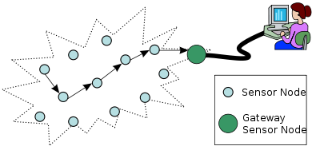
Introduction
Why is designing a centralized, self-organized wireless sensor network so important?
Limited power: communication
efficient and robust routing
Limited process speed: high calculation burden
put calculation burden on the PC side
Lack kernel protection and limited memory: difficult in coding
make test and implementation higher layer algorithm difficult
Notes:
可以统筹全局做出最优的路由规划，强大的计算能力。Wireless sensor network is playing an ever increasing role in our daily life, providing people with an interface to their surrounding physical environment, such as area monitoring, natural area monitoring and so on. However, due to harsh environment conditions, it's common for sensors cannot get access to a constant supply of power. Thus, power, typically stored in battery in motes, become a really precious resource. The biggest part of the power consuming is used for communications between nodes. As a result, efficient and robust routing that not only guarantees the packets of motes being delivered to the sink, but also saves the energy by avoiding re-transmission, attracts a tremendous attention from researchers. Furthermore, because of the goal of companies to produce a low cost tiny sensors, the memory and process speed become another precious resources. As a consequence, how to implement a desired system on motes becomes another hot issues in research field. Otherwise, you will get some unexpected results caused by the lack of kernel protection and process speed in motes system. Thus, a centralized, self-organized wireless sensor network, which can put the calculation burden on the PC side that is connected to the sink and command motes in the wireless sensor network to perform as it's required such as a robust routing, is crucial to improve the system efficiency and improve overall system life expectation.

Slide 3
Overall Aim
What my system can provide to solve these problems?
Build an initial routing tree
Provide useful and crucial information(e.g. link quality information) to Centralized control system
Distribute the commands from client program to the whole networks
Design a user-friendly interface that can hide physical implementation from client program

Slide 4
Methodology
Goal1:
Finding a software to simulate a real environment and can be adapted to different scenarios and applications
method1:
Compare different languages such as TinyOS, LiteOS, Contiki.
Choose tinyOS combined with TOSSIM, TOSSIM-LIVE, java, TinyOSAPI, python and MIG tools.
Experiment variable controllable and Experiment repeatable

Slide 5
Methodology
Goal2:
Building a channel model that satisfies the real industrial situations of wireless sensor network
providing a matrix in which elements represent the packet deliver rate of each channel.
Method2:
Use the power law and add Gaussian noise to calculate received power
Use covariance matrix to simulate shadowing effect
Add noise and interference collected from the library of Stanford
Set parameters to simulate a building aisle condition

Slide 6
Methodology
Goal 3 and Goal 4:
designing suitable data structure for data processing and data storing
building a initial routing tree
Method 3:
link table and pool data structure to save the link quality and routing information
quantize the packet deliver rate information from 0-255
design an algorithm to let motes automatically build an initial topology
Notes:
Constrained by limited power resources and process speed of motes and the payload length of packet
no routing trees at the beginning when all of the node are randomly distributed

Slide 7
Methodology
Goal 5:
Designing a logic clock in the mote
Designing a TDMA scheme
Solving the clock drift problem
Method 4:
Use physical clock fire event
Design a data structure to hold TDMA scheme
Design an algorithm to check the difference of actual time with the theoretical time

Slide 8
Methodology
Goal 6:
solving the packet collision problem when motes want to estimate the channel and forward their link quality information
Method 5:
CSMA/CA protocol for nodes to deliver and relay the link quality information packet to the sink
TDMA mechanism to let motes to estimate the channel sequentially.

Slide 9
Methodology
Goal 7:
designing an interface which can hide physical details from client program between TinyOS at the mote side and java application at the personal computer side.
Method 6:
A data structure used for programs to communicate
hides the physical implementation by using Message Interface generator to automatically build methods and classes.

Slide 10
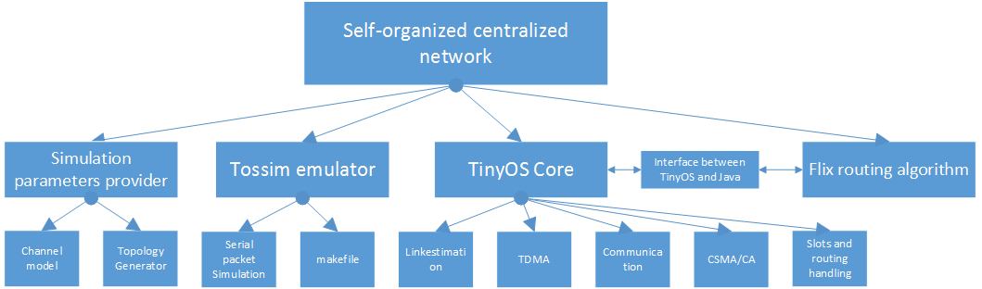
Implementation
Structure of my System:

Slide 11
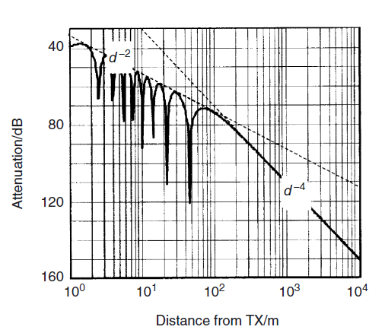
Parameters Provider
The power law
covariance matrix
Gaussian noise
Simulate a building aisle environment

Slide 12
Implementation
Flash

Slide 13
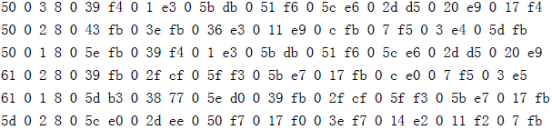
Results
Link quality information stored in log.txt
5d 0: number93 mote
2: two packets left
0 5c: number92 mote
e0: link quality(Packet deliver rate) is 224 -> 224/255 = 0.878

Slide 14
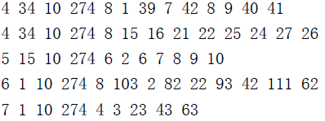
Results
The schedule information and routing tree created by Flix's program
7: number 7 mote
1: parent number 1 mote
274： frame length
4 :number of slots
3 23 43 64: Slot 3,Slot 23, Slot 43, Slot63

Slide 15
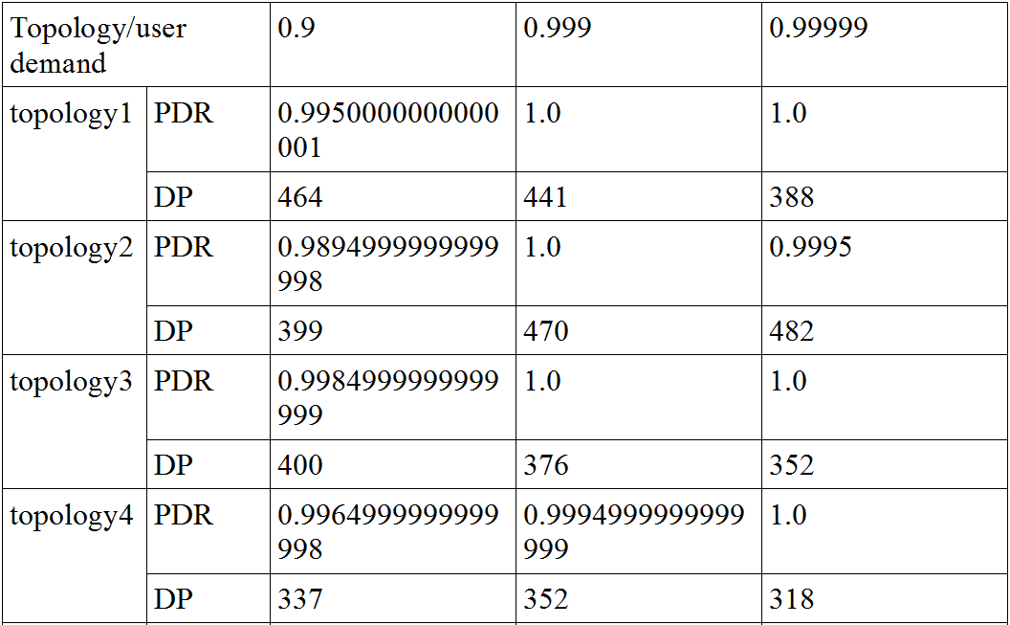
Results
Packet deliver rate in 20 frames with different user demand using Flix's Routing algorithm tested in my system

Slide 16
Conclusion
Designing a centralized, self-organized system is achieved
Serves the client program well
Pros:
Flexibility and user-friendly:
Serve different client programs
interface that automatically generate methods and classes without considering physical details.
Extendibility:
Channel model can be adapted into different scenarios like building aisle, football field and so on.

Slide 17
Future Work
implement a time synchronization between motes by using network time protocol
extend this system to a high mobility condition

Slide 18
Thank you!

